Slide 1

React JS

Slide 2
HOC: Higher Order Components
Module

Slide 3
Different Ways to Share Logic Among Components
Different patterns exist, following which we can share common functionalities among components
Higher Order Components
Render Props

Slide 4
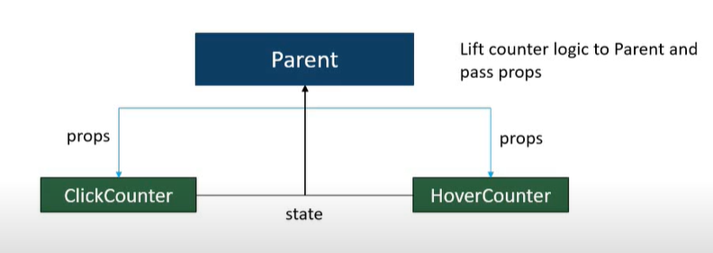
Why HOC?
We can lift the state to the parent component
Pass down the handler and state as prop to the child components
But that works well when all the components are children of the same parent component
if components are scattered in the component tree it would be difficult to lift State

Slide 5
What is HOC?
To share common functionality between components
A pattern which tales a component as an argument and returns a new component
Typically HOC adds additional functionalities and/or data to the original component
Hence the new component is referred as enhanced component
In short: a higher-order component transforms a component into another component.
A HOC is a pure function with zero side-effects
Is used by famous libraries like Redux, React Router and for styling in Material UI

Slide 6
withFunctionality HOC
data
callbackFunction
Original Component
Component with shared data and functionality
render function
render function
<p>{props.value}</p>
props
<button onClick={props.callback}> Click </button>
value={data}
Original Component
callback={callbackFunction}
withFunctionality(Original)
Enhanced Original Component Returned
<Original />

Slide 7
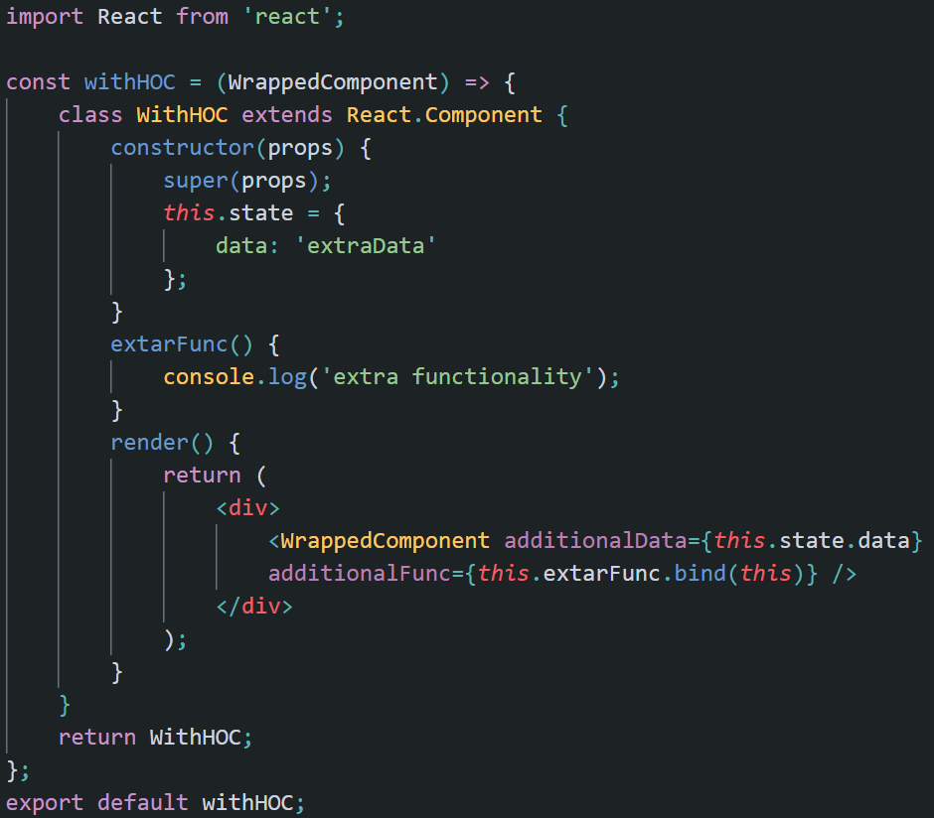
HOC: Just a Function

Slide 8
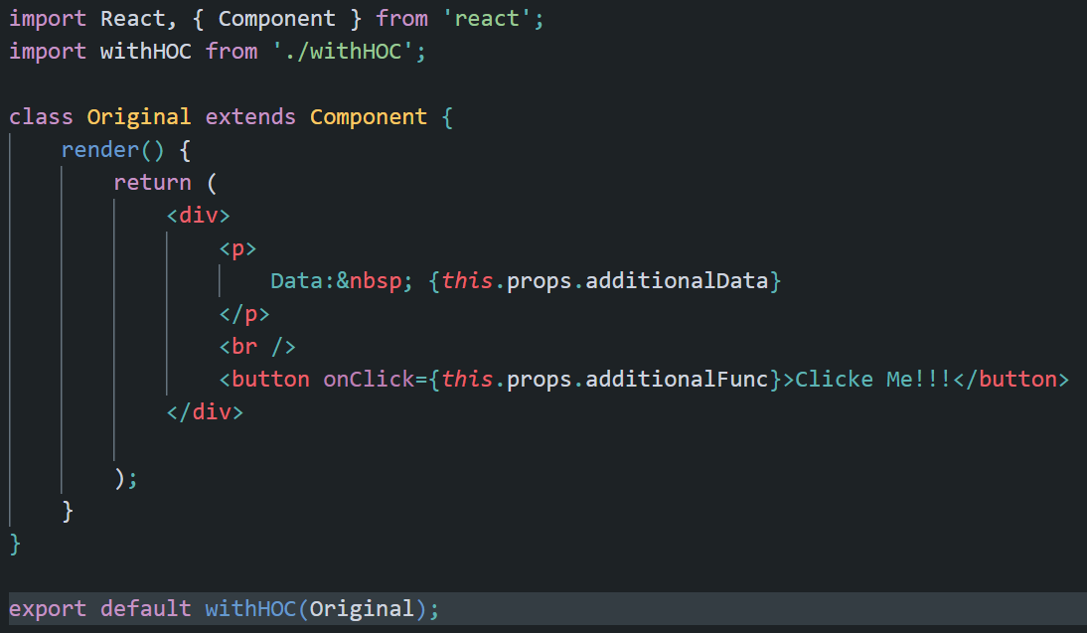
HOC: Wrapped Component

Slide 9
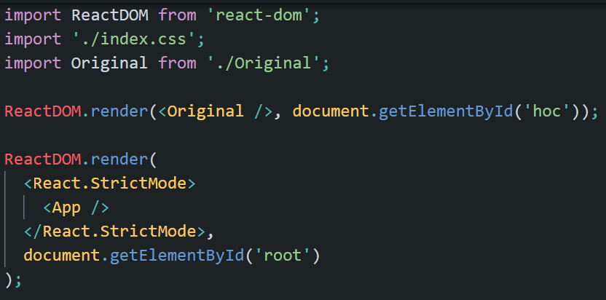
How Wrapped Component Being used?

